Slide 1
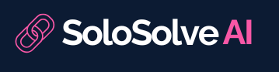


The Team
Shoval Benjer
Alon Berkovich
Adir Amar
Dr. Yair Even Zohar
Mentor

Slide 2
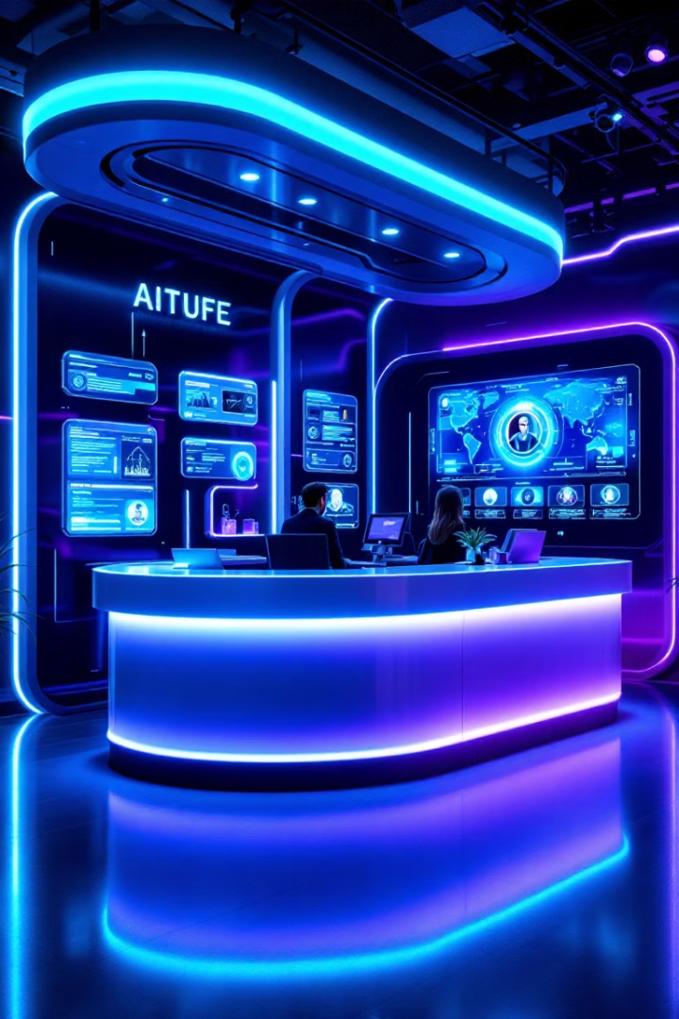
AI-Powered Complaint Management System
Welcome to our presentation on the AI-powered complaint management system for online delivery services. This innovative solution aims to revolutionize customer complaint processing through advanced Natural Language Processing (NLP) and decision-making algorithms.
Our system will streamline information extraction, apply business-specific compensation rules, and resolve issues efficiently with minimal human intervention. Let's explore how this technology will transform customer service in the delivery industry.

Slide 3
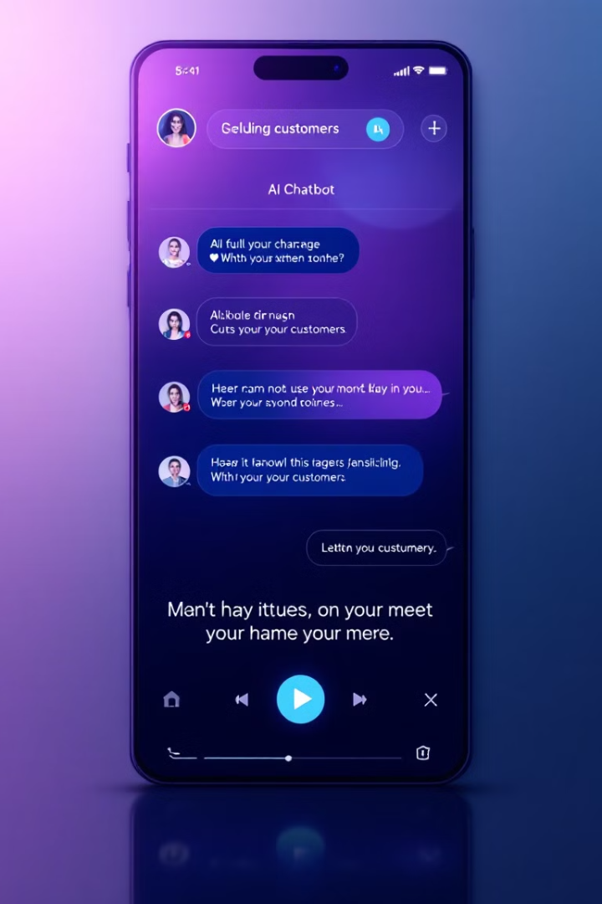
AI in Customer Service: Key Insights
Automation
Multi-Channel Support
AI technologies streamline processes and improve complaint resolution efficiency
AI-powered systems classify and manage complaints across various channels
Enhanced Customer Experience
Faster resolution times and personalized interactions improve satisfaction

Slide 4
AI Agents in Customer Success
Chatbots
Recommendation Systems
Intelligent Routing
AI-based chatbots improve user compliance and overall satisfaction by providing instant, personalized responses
Machine learning frameworks like ICS-Assist recommend solutions to customer inquiries, improving efficiency in complaint resolution

Slide 5

Information Extraction Techniques
1
Unstructured Data Analysis
Techniques for extracting meaningful insights from unstructured and multidimensional data relevant to complaint analysis
2
Deep Learning Methods
Advanced NLP techniques enable efficient processing of large volumes of complaints
3
Speech and Entity Recognition
Techniques for extracting key entities from customer conversations using speech recognition and named entity recognition

Slide 6
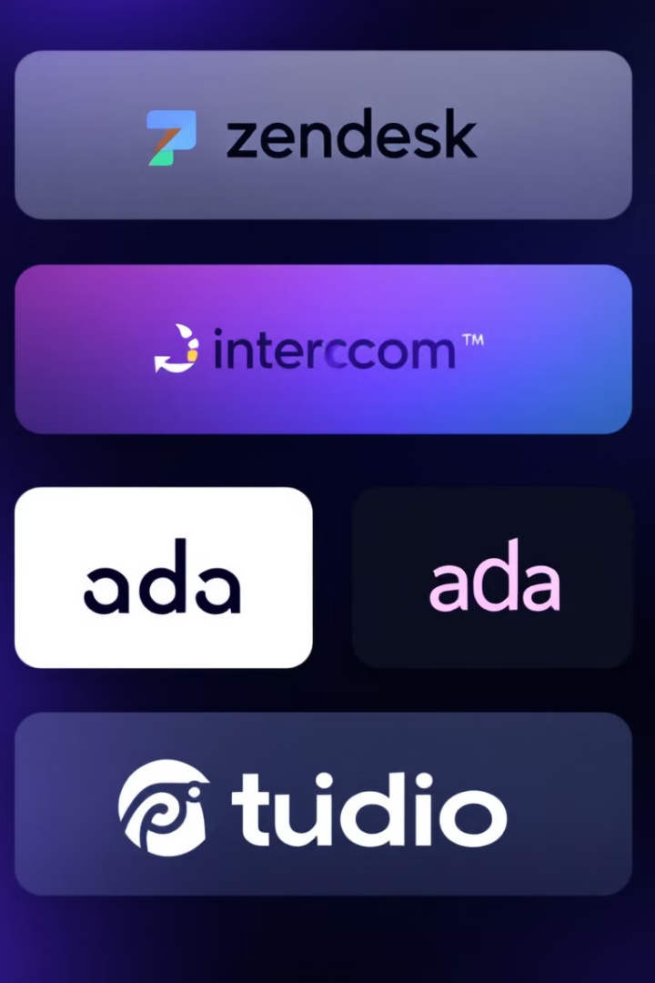
Competitor Analysis: Direct Competitors
Competitor
Key Features
Target Audience
AI Capabilities
Zendesk
AI chatbots, ticketing, knowledge base
Medium-large enterprises
OpenAI chatbots, predictive support
Intercom
AI chatbots, live chat, messaging
SaaS businesses
Advanced NLP, human-like responses
Ada
AI voice bots, analytics tools
Large enterprises
Self-learning bots, robust NLU
Tidio
Lyro AI, live chat, visitor tracking
SMBs/startups
Automates 70%, easy to use

Slide 7
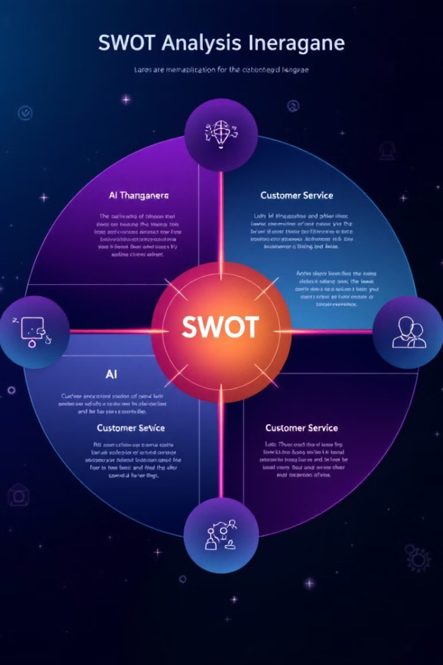
SWOT Analysis
Strengths
Weaknesses
AI-powered chatbots and automation are standard across competitors, ensuring advanced customer service capabilities
Mixed customer satisfaction for some competitors, highlighting potential gaps in customer experience
Opportunities
Threats
Increasing global demand for AI-driven customer service solutions across industries provides room for growth
Intense competition from established direct and indirect competitors, rapid technological advancements in AI/NLP

Slide 8
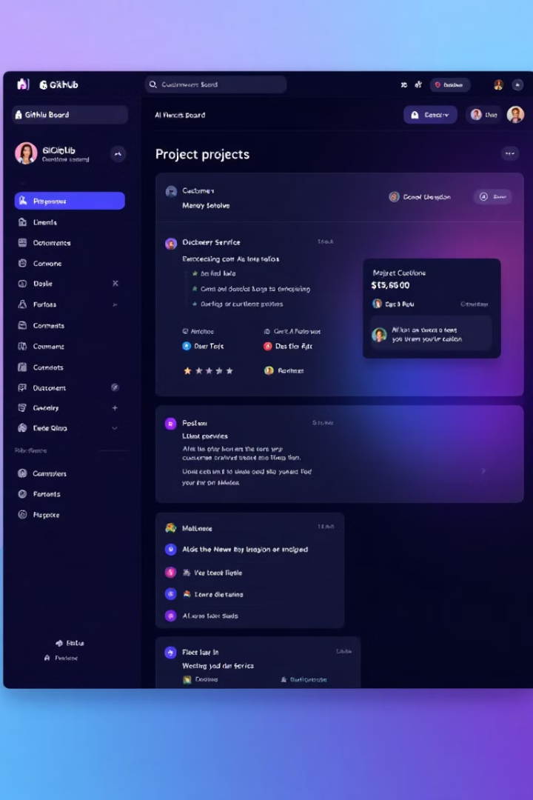




Roadmap Implementation
Define Project Scope
Outline tasks and activities required for the Customer Service App, including core features and AI integration
Task Breakdown
Break down the project into specific tasks and subtasks, adhering to SMART criteria
GitHub Projects Integration
Utilize Kanban boards, issue tracking, and milestones for efficient project management
Regular Progress Reviews
Hold weekly team meetings to discuss progress and make necessary adjustments

Slide 9

Key Takeaways and Next Steps
1
Enhance AI Capabilities
2
Flexible Pricing Strategy
Develop advanced features like predictive insights and self-learning models to align with market leaders
Introduce tiered pricing models catering to both SMBs and enterprise clients
3
Target Niche Markets
4
Strengthen Integration
Explore specialized industries such as healthcare and food delivery for market differentiation
Form partnerships with CRM providers and enterprise tool vendors for better compatibility

Slide 10


Slide 11
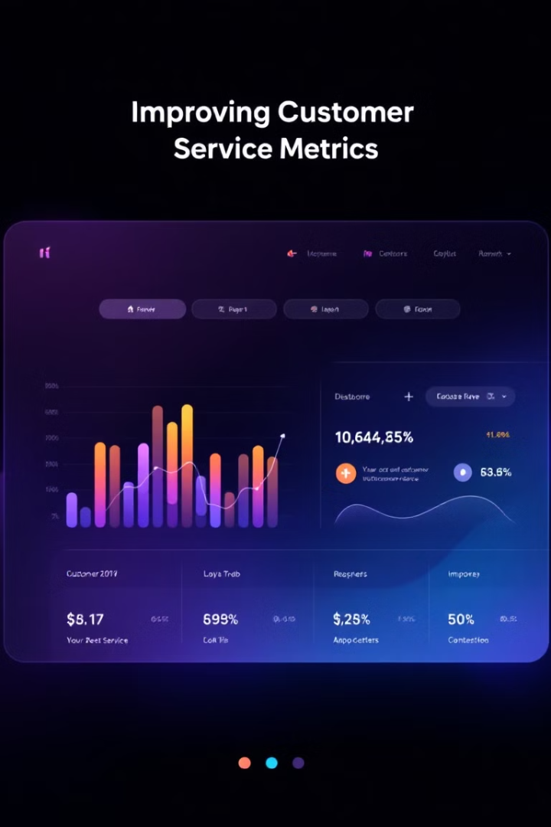
Key Objectives and KPIs
Reduce Resolution Time
Improve First-Time Resolution
Decrease average complaint resolution time by 40%, enhancing customer satisfaction through swift problem-solving.
Achieve a 90% first-time resolution rate, minimizing the need for follow-ups and escalations.
Boost Customer Satisfaction
Increase customer satisfaction ratings by 20% within six months of deployment, fostering loyalty and positive brand perception.

Slide 12





Core Functional Requirements
User Authentication
Complaint Classification
Implement secure login and role-based permissions for different user types.
Automatically categorize and prioritize complaints based on urgency and severity.
Resolution Recommendation
Complaint Tracking
Develop an engine to suggest resolutions based on complaint type and policies.
Provide a dashboard for users to monitor complaint status and progress.

Slide 13
Advanced Features
Proactive Issue Identification
Sentiment Analysis
Real-Time Collaboration
Implement analytics to detect recurring complaint patterns and suggest system-level improvements, enabling businesses to address root causes proactively.
Utilize NLP techniques to track shifts in customer sentiment from initial complaint to resolution, providing valuable insights into the effectiveness of the resolution process.
Enable support agents to collaborate on complex or escalated complaints in real-time, ensuring quicker resolution of challenging issues.

Slide 14





Technical Architecture
Modular System Design
Implement a flexible, scalable architecture with independent components for complaint submission, resolution engine, and notification system.
Cloud-Based Infrastructure
Utilize AWS for cost-effective, scalable services with strong NLP tools and GDPR compliance. Alternate option: Google Cloud for excellent AI capabilities.
Database and Backend
Use PostgreSQL for structured data handling and Flask for a lightweight, modular backend framework supporting RESTful API development.
Version Control and CI/CD
Implement GitHub for familiar collaboration tools and seamless integration with CI/CD workflows via GitHub Actions.

Slide 15

Regulatory Compliance and Security
Algorithmic Transparency
Data Privacy and Security
Ethical AI Practices
Conduct regular audits of AI algorithms, implement explainable AI models, and provide clear disclosures about AI decision-making processes to enhance user trust.
Implement AES-256 encryption for data at rest, TLS 1.3 for secure transmission, and role-based access control. Ensure compliance with GDPR and HIPAA standards.
Design algorithms prioritizing equity and fairness in complaint handling, incorporating feedback loops to refine decision-making processes continuously.

Slide 16
Project Timeline
1
Platform Architecture and Design
November 10, 2024 – December 22, 2024
2
Develop Core Automated System
December 23, 2024 – March 15, 2025
3
Client Customization Interface
February 16, 2025 – April 15, 2025
4
User Interface Design
March 16, 2025 – May 10, 2025
5
Integrations and Testing
April 1, 2025 – June 10, 2025
6
Deploy and Monitor
June 1, 2025 – June 30, 2025

Slide 17

Next Steps and Conclusion
As we move forward with this innovative AI-powered complaint management system, we're poised to transform customer service in the delivery industry. Our focus on efficiency, scalability, and user satisfaction will drive significant improvements in complaint resolution and overall customer experience.
Next steps include finalizing the technical architecture, beginning core system development, and engaging with potential clients for early feedback. We're excited about the potential impact of this system and look forward to its successful implementation.

